Slide 1
Progress Report Working Group on Rights and Empowerment
Ninuk Widyantoro
FP2020 County Committee Meeting, BKKBN
18 March 2014

Slide 2
Main purpose of the WG Rights and Empowerment
To ensure that the framework for accelerating progress towards Family Planning is rights-based:
Client perspective
Comprehensive and accurate information and informed consent

Slide 3
Members
Ninuk Widyantoro, Psychologist (chair)
Dr. Setiawati Firman Lubis, MPH
Dr. Renny Bunyamin, MPH (Lombok)
Dr. Kadek, SpOG (Bali)
Mrs. Maria Ulfah Anshor (NU)
Mrs. Indra Supradewi (IBI)
Mr. Angga Dwi Martha (UNFPA)

Slide 4
Activities Performed
WG Rights and Empowerment meeting to discuss the TOR.
Combined meeting with WG on FP Strategy that introduced Indonesia’s commitment toward FP2020 → First meeting meeting on 24 February 2014
Compiling studies related to KAP in family planning.
Meeting to discuss the work plan, including brainstorming on the KAP study → 17 March 2014

Slide 5
Key Issues Discussed
To identify current barriers that prevent women from their rights to exercise access to information and services to meet their reproductive goals through a study.
Barriers of young people to access information and services.
Empowerment through information and education on SRHR and creating enabling environment.

Slide 6
Next Steps
Develop protocol for the study.
Identify the study sites (slum/rural, urban; moslem and non-moslem).
Identify informants/resource persons → married (male, female); young people (married & unmarried); service providers; decision makers).
Developing tools.

Slide 7
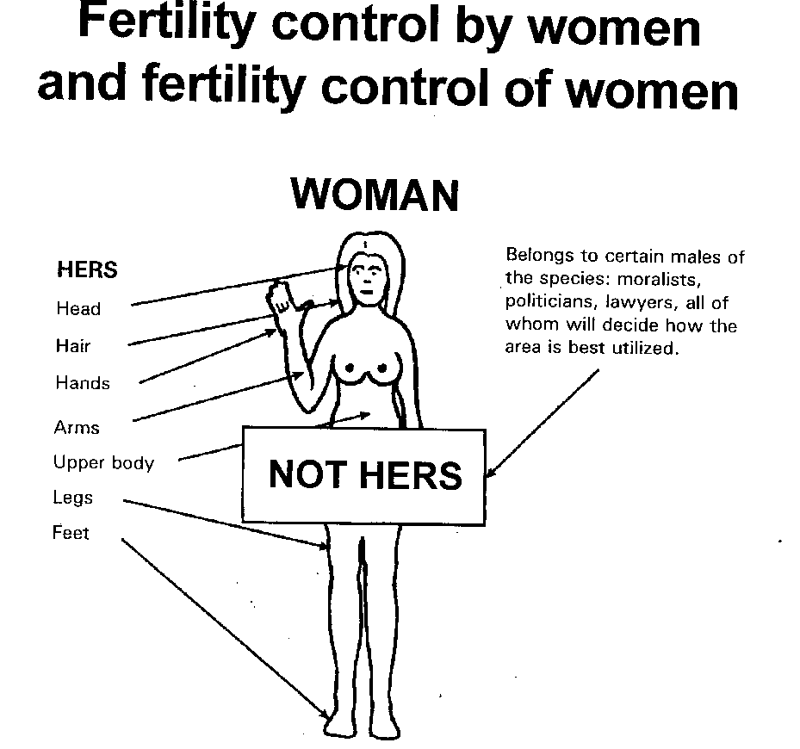

Slide 8
Thank You

